Slide 1


Kakioka’s cooperation in DD checking ~ with some requests ~
Seiki Asari（Kakioka Magnetic Observatory, JMA, Japan）
Intermagnet Meeting 2019, Ottawa, 20-22 July
<number>
Notes:
Thanks for allowing me time to introduce our recent decision to join the Definitive Data checking group and associated requests from us
<number>

Slide 2
Speaking of Kakioka…
High quality data
Centennial history
One of 4 Dst Observatories
In mystery?
Let’s get more outgoing!!
Intermagnet Meeting 2019, Ottawa, 20-22 July
USGS comic book “Journey along a field line”
<number>
Notes:
<number>

Slide 3
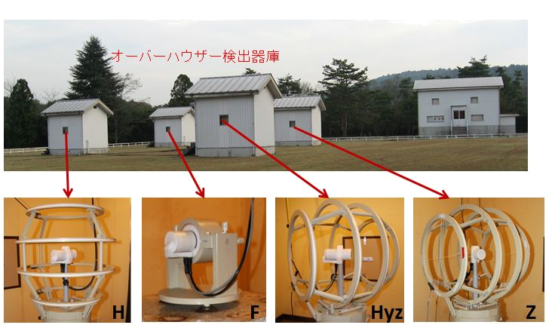
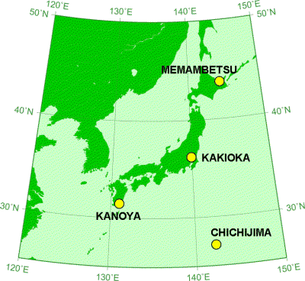
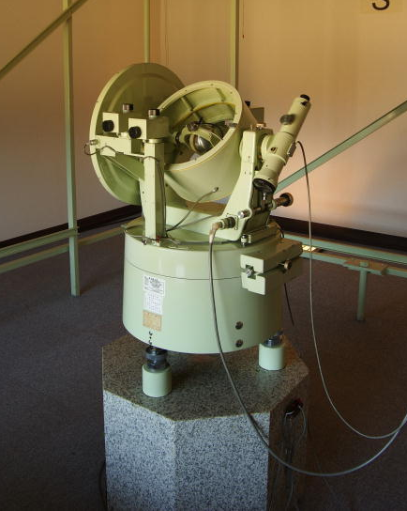
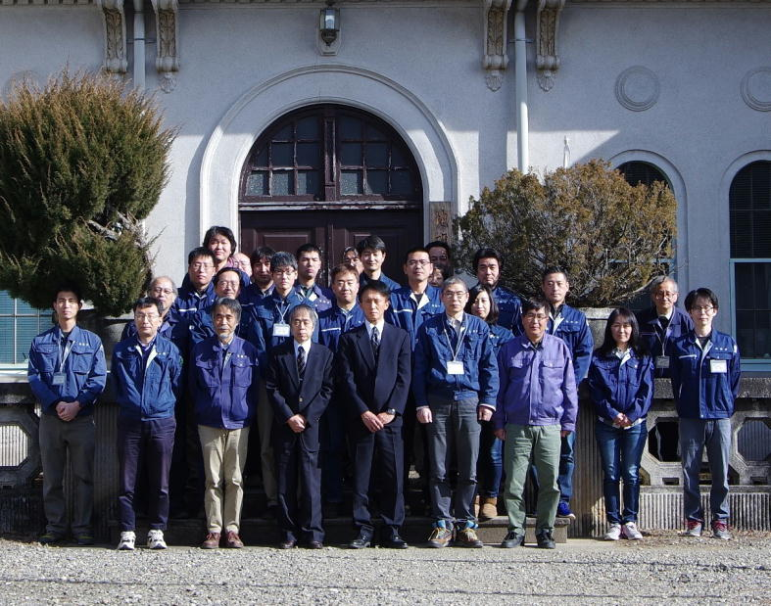
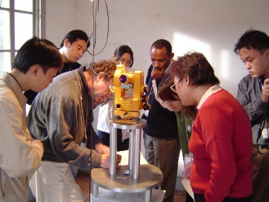
Kakioka observatory
Intermagnet Meeting 2019, Ottawa, 20-22 July
<number>
Notes:
About 30 people working
On top of fluxgate, we have a vector measurement system using overhauser GSM-90.
DI-72: Over a hundred kg,
still in use for weekly absolute
Observation
Based on the principle before the advent of DI-flux
<number>

Slide 4

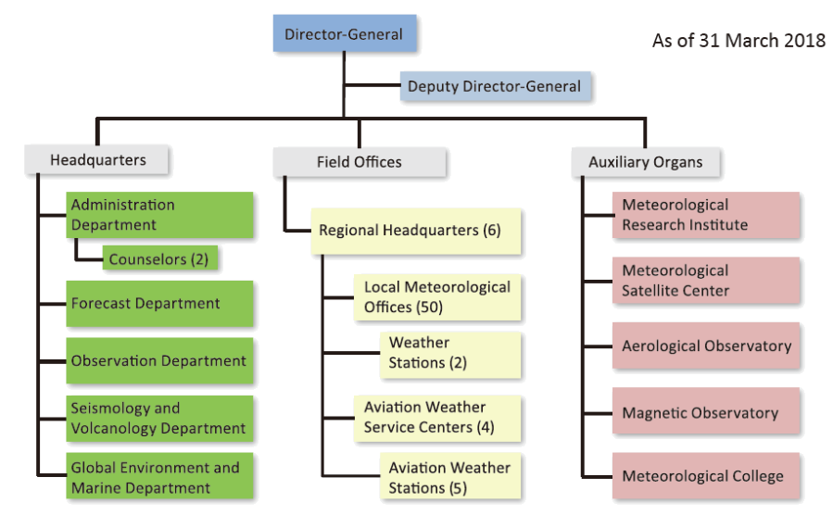


Kakioka: a governmental institution
JMA structure
Government of Japan
Ministry of Land, Infrastructure, Transport and Tourism
Japan Meteorological Agency (JMA)
Intermagnet Meeting 2019, Ottawa, 20-22 July
<number>
Notes:
We are national authority.
<number>

Slide 5
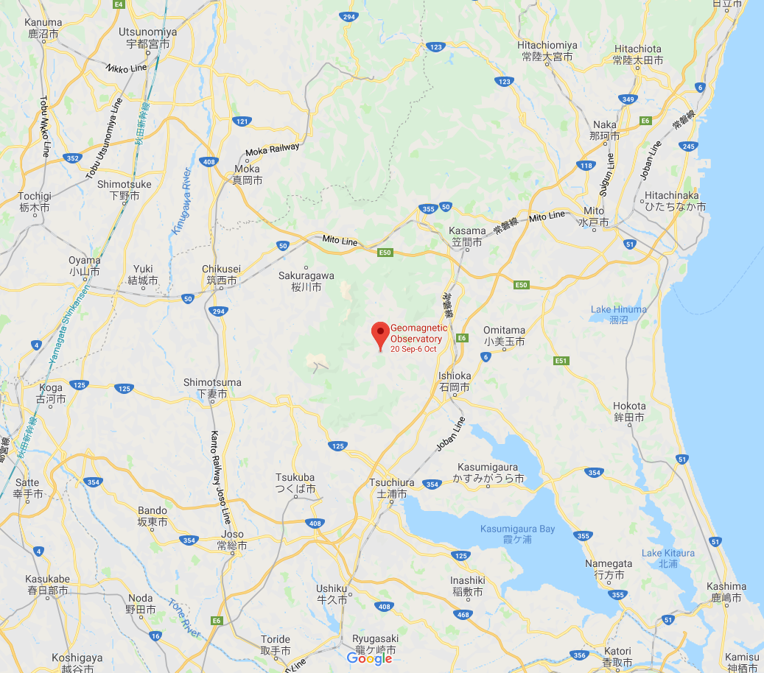

Being a public institution/civil servants…
Enjoy protection by law
Suffer Japanese bureaucracy
Electricity Business Act
Red tape
35km
KAK
Many protocol documents are required to authorize their activities,
such as international services!
DC-electrified
Diesel-powered
AC-electrified
Intermagnet Meeting 2019, Ottawa, 20-22 July
<number>
Notes:
Inside a circle centered at Kakioka obs. with radius of 35km, it is forbidden to run DC-powered trains.
May be able to use the government power.
On the other hand,
<number>

Slide 6
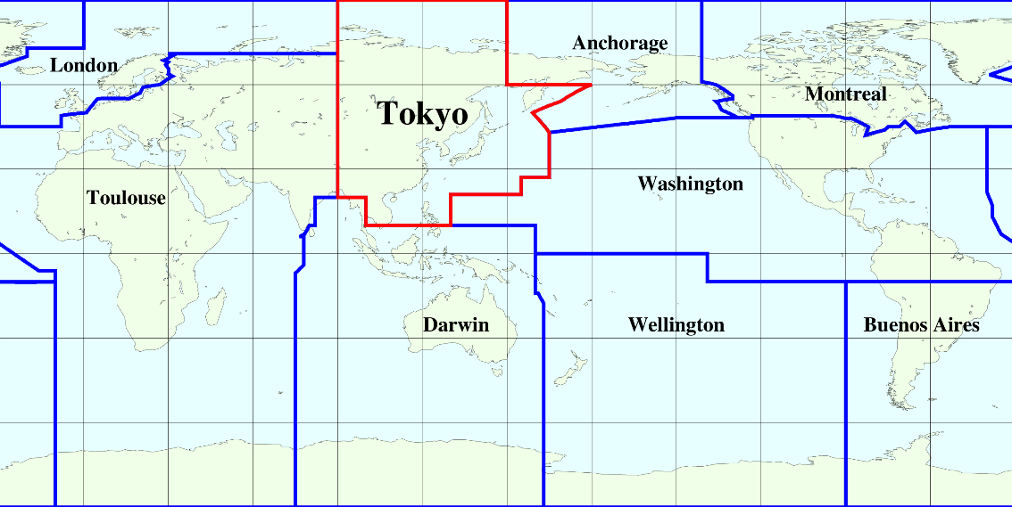



Some existing JMA services in international framework
Numerical Weather Prediction
Regional Specialized Meteorological Center (RSMC) Tokyo – Typhoon Center
under WMO World Weather Watch Programme
Tsunamis
Northwest Pacific Tsunami Advisory Center (NWPTAC)
under Intergovernmental Oceanographic Commission (IOC) of UNESCO
Atmospheric Environment
World Data Centre for Greenhouse Gases (WDCGG) under WMO Global Atmosphere Watch (GAW) programme
Volcanic Ash
Information and Communications
Volcanic Ash Advisory Center (VAAC) Tokyo
under International Civil Aviation Organization (ICAO) with WMO
Global Information System Centre (GISC) Tokyo
under WMO Information System (WIS)
Instrument Maintenance and Calibration
under UN subsidiary organs!
WMO Regional Instrument Centre (RIC) Tsukuba
Intermagnet Meeting 2019, Ottawa, 20-22 July
<number>
Notes:
Authority under authority, prestige
<number>

Slide 7
Kakioka’s Requests
To get the DD checking officially admitted by JMA headquarters …
some documents are needed to show Kakioka’s active membership in the INTERMAGNET (sub)programs.
Kakioka requests issuing of
Very unfavorable!
(1) a list of “DD checking TASK TEAM”
(2) a list of annual meeting participants without using the title “Observer/Guest”
Intermagnet Meeting 2019, Ottawa, 20-22 July
<number>
Notes:
Apart from authority, it is essential to show that we are really a part of international consortium, if we are to get…
<number>

